Slide 1

: Ice Breaker
Surya Kandukuri
www.factly.in
Open Data Telangana

Slide 2
Learning Goals
What is R?
Why we use R?
How to read data into R
Getting familiar with basic commands & coding
More of R: What next?

Slide 3
R: What is it and Why we use it
Open-Source, cross platform, free Statistical Language and Program
Works on Windows, Mac-OS, Linux, Unix platforms
Flexible: own functions, modify existing function/commands to suit your purpose
Powerful: Open source, Constantly being updated by users ( Scientists, Statisticians, Researchers, Students!)
And: Beautiful Graphics, Facilitates research, comes with an enormous library of pre-defined functions, can be integrated into many environments and platforms such as LaTex, Hadoop etc

Slide 4
Installing R
Can be downloaded for free from http://www.r -project.org/
Download the version compatible with your OS
Simple/Standard installation process

Slide 5
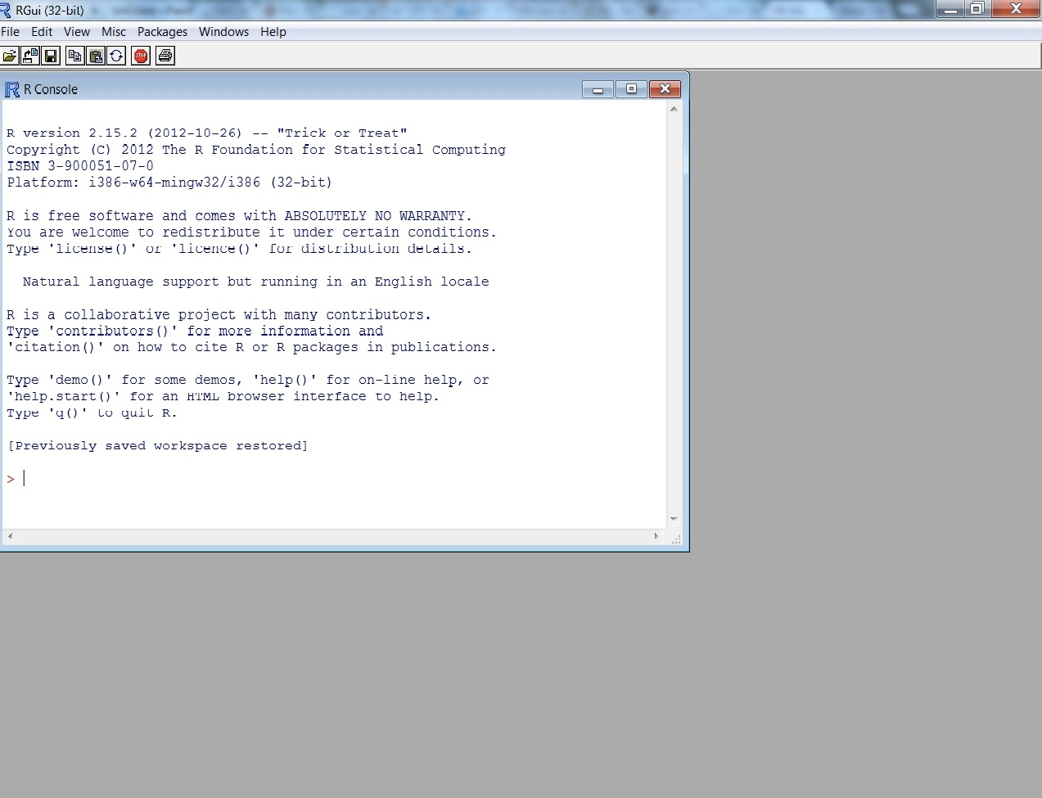
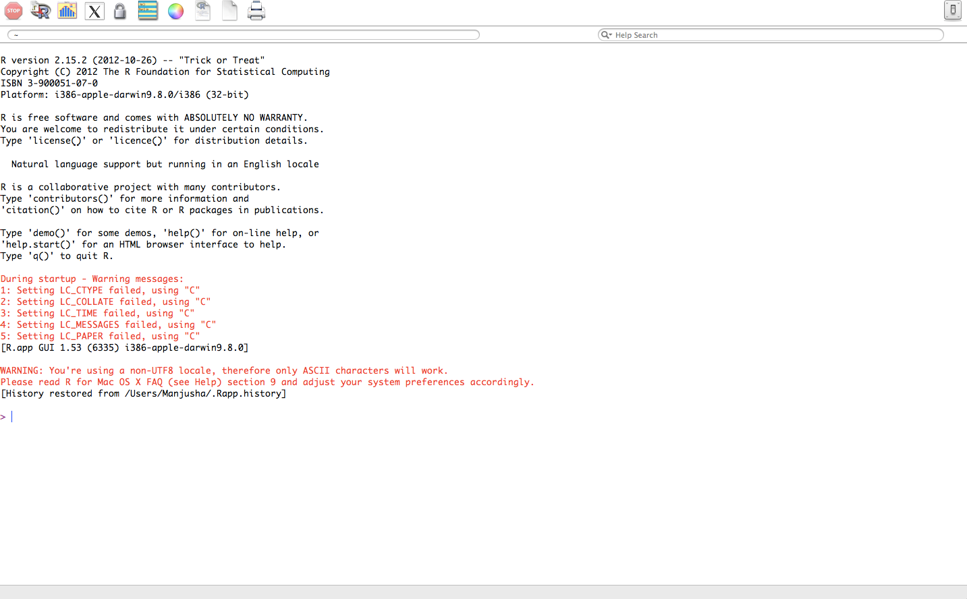
R Interface
Windows
Mac

Slide 6
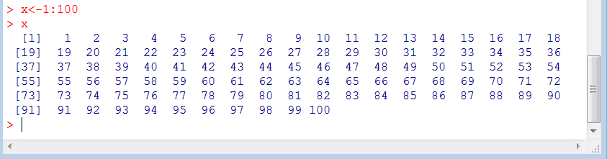
Interacting with R
We have seen in the console the command prompt ‘ >’, indicating that we must begin entering our command
Basic Rule: Type a command and hit enter to execute it
E.g. x<-1:100 (create a vector of length 100, with elements 1,2,3,4……..100)

Slide 7
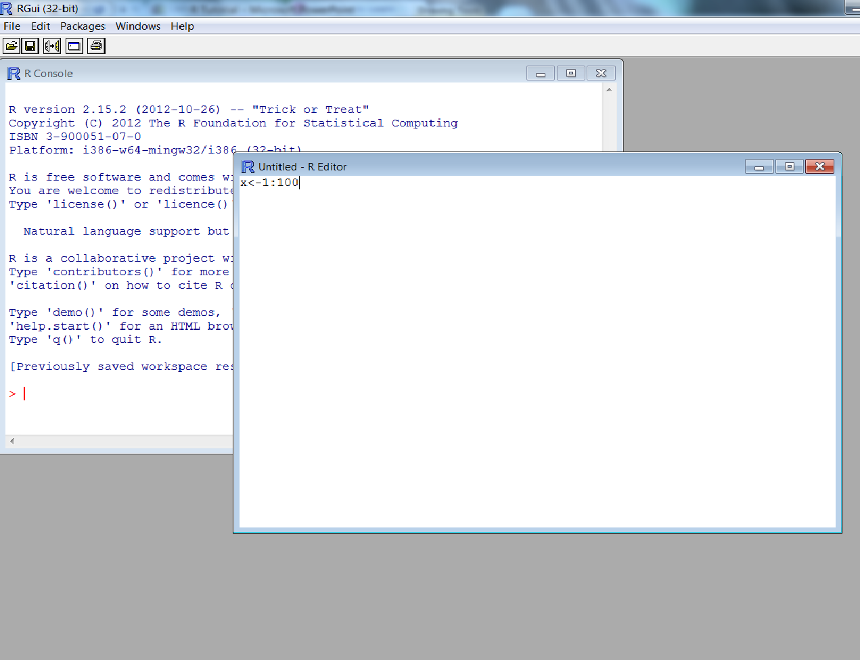
Interacting with R: R Script
Can write and save codes here
file→ New script
Or ‘ctrl+N’
Write code, select the part you want to run and ‘ctrl+R’ to execute

Slide 8
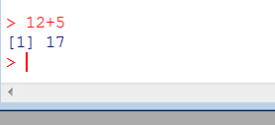

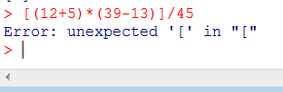
R Console: As a Calculator
Type this in the console:
12+5 → Enter
Let us try something more complex:
(12+5)*(39-13) /45→ Enter
Can be used like any other calculator
WARNING: Beware of lurking square brackets
[(12+5)*(39-13)]/45→ Enter
We will see later on in this tutorial that ‘[]’ means something else in R.
Much more than a calculator!
8

Slide 9
R Commands
Are mostly in the form of functions
E.g.: plot(x,y), mean(x)
How do we tell R what x and y are?
We can assign values to x and y ourselves
Or import a dataset that contains x and y
We will learn this through examples

Slide 10
R: The Very Basics
Essential basics to move forward with R:
Create your own Objects (Variables, Vectors, Matrices, Lists etc)
Assign names to these Objects
Learn to access an Object or any subset/part of it
Perform simple calculations, transformations on these objects

Slide 11
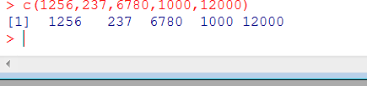
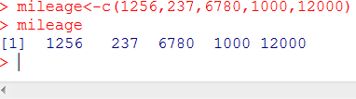
R: The Very Basics
Vectors
Suppose you own 5 cars
Type: Compact, Minivan, SUV, Roadster and a Pickup Truck
– Mileage: 1256,237,6780,1000,12000
Let us define our first vector using the ‘c’ function in R, which “Combines Values into a Vector or List”
Vector Mileage
Create the vector:
c(1256,237,6780,1000,12000)
Assign the name ‘mileage’ to this vector using ‘ ->’ mileage<-c(1256,237,6780,1000,12000)

Slide 12
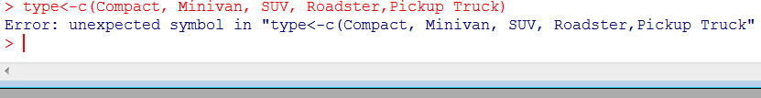
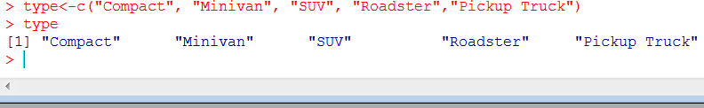
R: The Very Basics
Vectors contd…
– Vector “type”
type<-c(Compact, Minivan, SUV, Roadster,Pickup Truck)
For creating a vector of string components, we use “ “ to separate the elements. This would work:
type<-c(“Compact”, “Minivan”, “SUV”, “Roadster”,”Pickup Truck”)

Slide 13
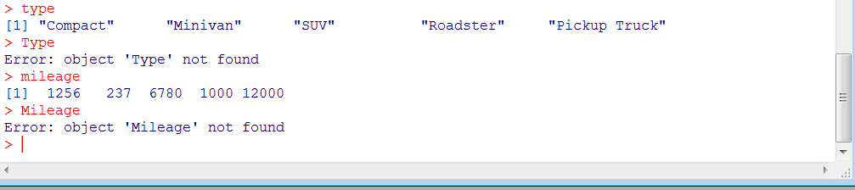
R:Tip 1
R is case sensitive

Slide 14
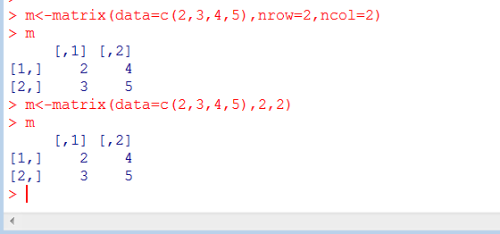
R: The Very Basics
Matrices, Data Frames
Create a simple 2x2 matrix, lets call it ‘m’:
m<-matrix(data=c(2,3,4,5),nrow=2,ncol=2)

Slide 15
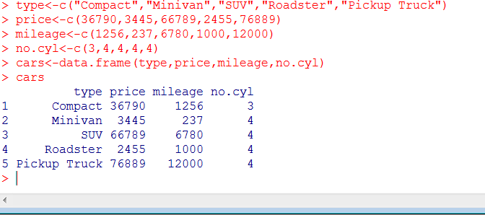
R: The Very Basics
Matrices, Data Frames Contd…
Consider the 5 cars in our previous example, along with ‘type’ and ‘mileage’ , the following data is also available:
– Price, price<-c(36790,3445,66789,2455,76889)
– Number of cylinders in the engine,
no.cyl<-c(3,4,4,4,4)
Create a Data Frame that contains all this information:
cars<-data.frame(type,price,mileage,no.cyl)

Slide 16
R: Packages
Are a collection of R functions and data sets
Few standard ones come with the R installation, others have to be downloaded ( from http://cran.r -project.org/ , or a simple Google search could lead you to the download site) and manually installed
Or the packages can be installed using
“install.packages(“package name”)“ and select the CRAN Mirror closest to your location
Once installed we need to call the package in when needed using “library(“package name”)”
16

Slide 17
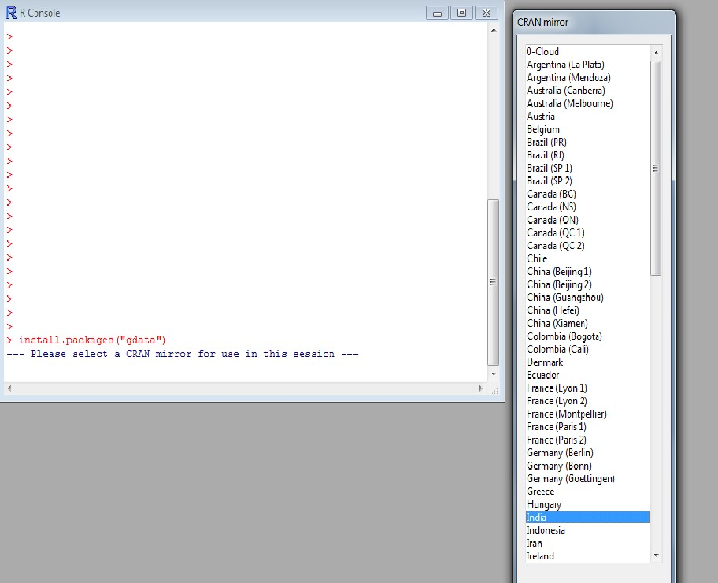
R: Packages
Example
Example:
Package: ‘gdata’
Various R programming tools for data manipulation

Slide 18
R: Working Directory (WD)
Some location/Folder on your PC where you have the data, code etc
You want to import files, code from this location
You want to save your output here
Setting a WD on starting your R session makes importing, exporting data files, code files etc easier

Slide 19
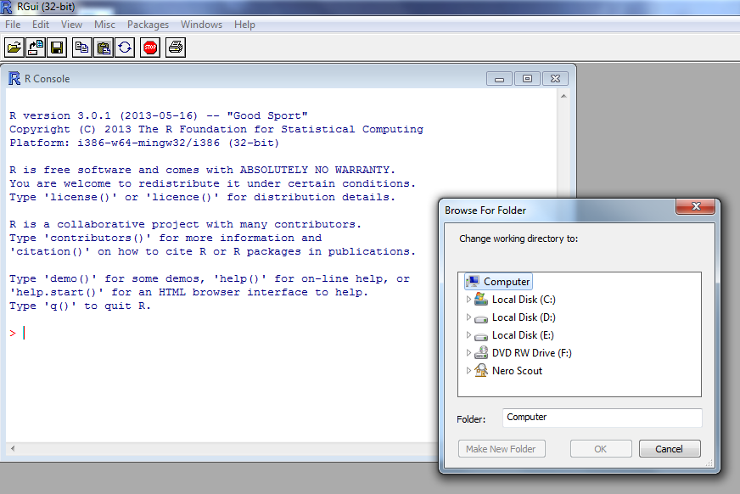
R: Working Directory
file→ change dir..

Slide 20
R: Importing Data
More often than not , data are already available in different formats ready to be imported to R.
R accepts files of many formats, we will learn importing files of the following formats:
Text (.txt)
CSV (.csv)
Excel (.xls)
SPSS ( .sav)
STATA (.dta)
SAS (.ssd)
(For more formats you can visit http://cran.r - project.org/doc/manuals/R -data.pdf , here you get information on how to import image files as well ! )

Slide 21
R: Importing Data
Text , C S V and Excel files
Text Files:
Comma Delimited Text Files:
data1<- read.table("C:/Users/xyz/Desktop/folderX/mydata.txt", header=TRUE, sep=",“)
Space as the separator:
data1<- read.table("C:/Users/xyz/Desktop/folderX/mydata.txt", header=TRUE)
Another(easier) way, set your working directory then the command is:
data1<- read.table("mydata.txt", header=TRUE)
CSV Files:
Similar way, use ‘read.csv’ instead of ‘ read.table’
Excel Files:
Use read.xls (needs package ‘gdata’, use ‘library(gdata)’ after installing this package)

Slide 22
R: Importing Data
From other Statistical Software
SPSS:
Need library ‘foreign’
Use command: ‘read.spss’
STATA:
Need library ‘foreign’
Use command: ‘read.dta’
SAS:
Need library ‘foreign’
Use command: ‘read.ssd’

Slide 23

R: Tip 2
For any help on any function just type the following in the R console:
?’fucntion name’
Or
help(‘function name’)
We don’t see anything here as these commands take you to a webpage where the function and its arguments are explained.

Slide 24
R: Master Example
The Used Cars Data:
Data collected from Kelly Blue Book for several 2005 Used cars
Interest is to determine a model for car value based on a variety of characteristics such as mileage, make, model, engine size, interior style, and cruise control
810 observations, 12 variables
File name: ‘Used Cars’, CSV format

Slide 25
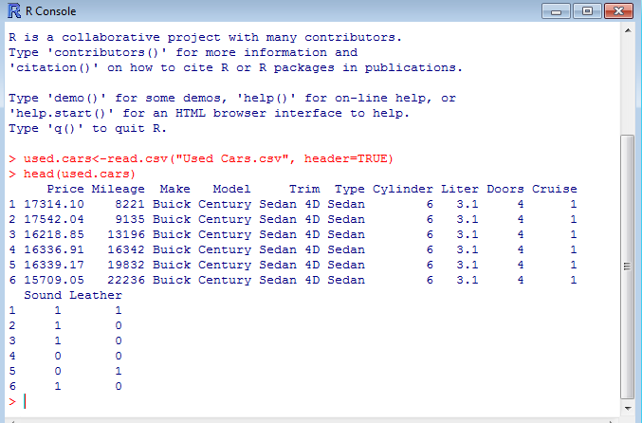
R: Master Example
Input the Used cars data

Slide 26
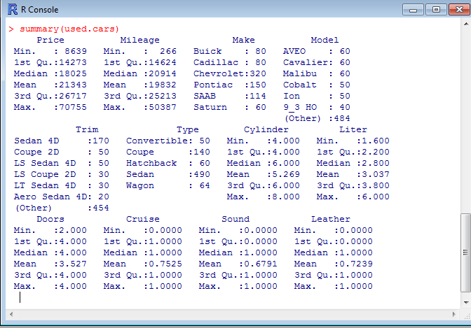
R: Master Example
Summary of the Data

Slide 27
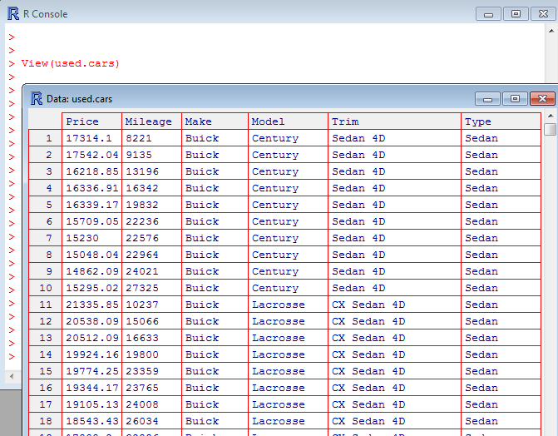
R: Master Example
View the Dataset

Slide 28
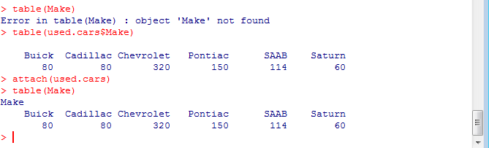
R: Master Example
Variable Calling
Suppose you want a frequency table of the ‘Make’ variable:
– Use function ‘table()’

Slide 29
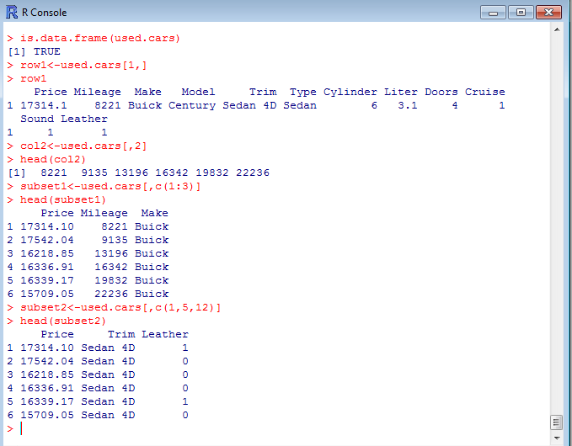
R: Master Example
Certain Rows or Columns in the Data set

Slide 30
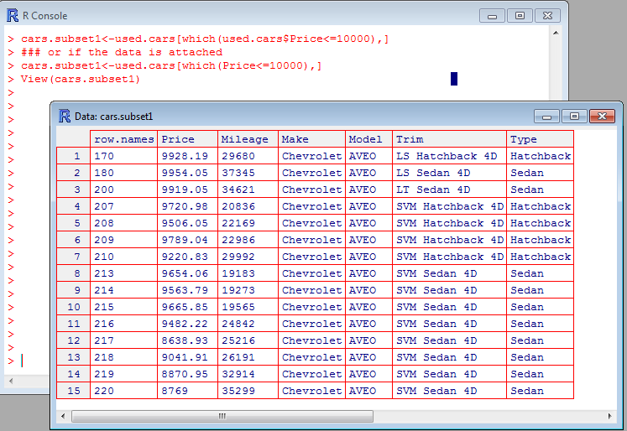
R: Master Example
Subsets of the data
How to obtain a subset that contains cars whose price is less than or equal to 10,000 Dollars?
– Use the ‘which’ function
cars.subset1<-used.cars[which(used.cars$Price<=10000),]

Slide 31
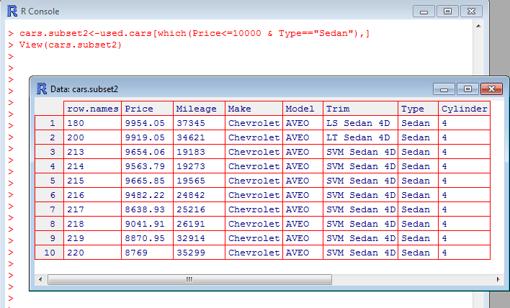
R: Master Example
Subsets of the data contd
Sedans that cost less than 10000 Dollars
cars.subset2<-used.cars[which(Price<=10000 & Type=="Sedan"),]

Slide 32
R: Master Example
Subsets of the data contd
Other functions:
‘subset’:
cars.subset2<-subset(used.cars,Price<=10000 & Type=="Sedan")
‘sample’ : For random samples
For more, you can look at:
http://www.ats.ucla.edu/stat/r/modules/subsetting.htm

Slide 33
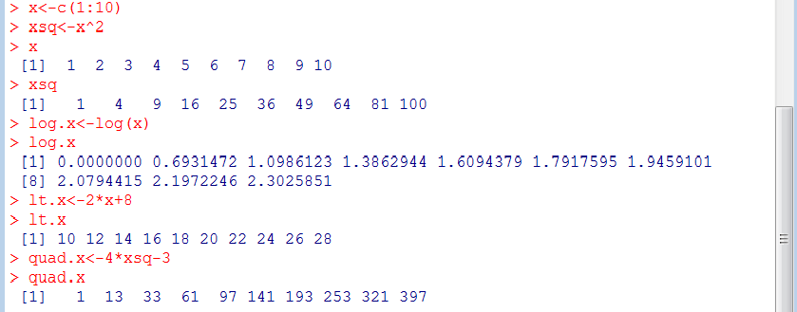
R: Transformations

Slide 34
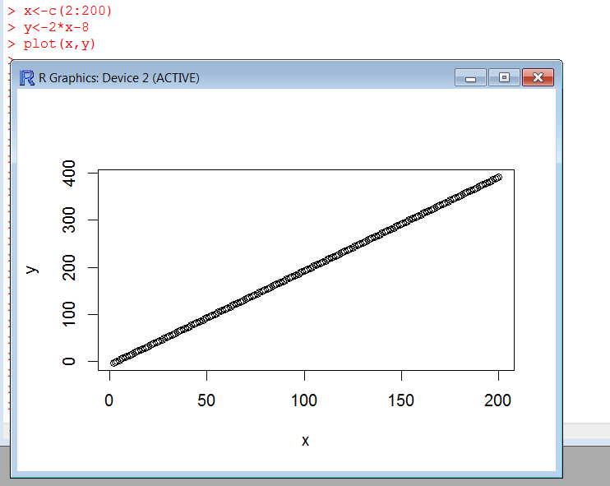
R: Plots

Slide 35
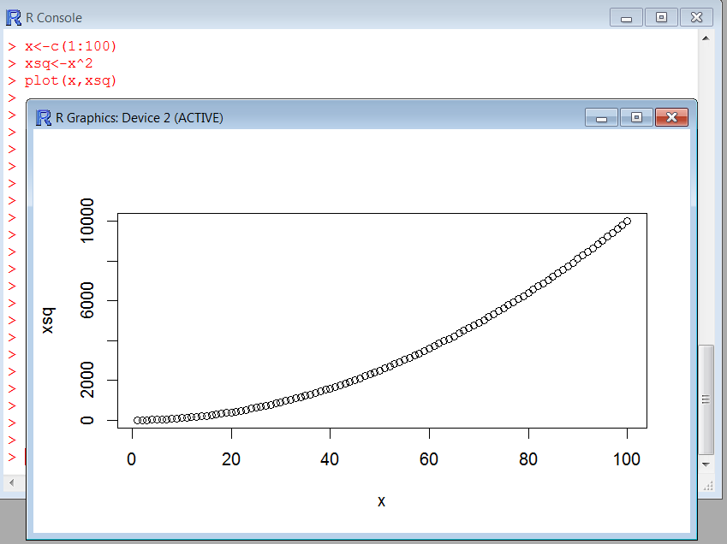
R: Plots Contd…

Slide 36
R: Write your own functions
Syntax:
my.function<-function(arg1, arg2,….) { Statement 1
Statements 2
:
return(return.value)
}
Example: Add two numbers/vectors
addition.mine<-function(x,y) { return(x+y) }
Example: Sum of Diagonal elements of a matrix ( Trace of a matrix)
trace.mine<-function(mat) { sum(diag(mat)) }

Slide 37
R Studio
A free and open source integrated development environment (IDE) for R
Can be downloaded from
http://www.rstudio.com /

Slide 38
R: Extra Help
Rseek : An exclusive R search engine
More help and resources:
R-bloggers
UCLA’s R help
Quick-r
R-help
Google!
38

Slide 39

Thank you

